Slide 1

A New approach for Crime Rate Prediction Using Machine Learning
Seminar By,

Slide 2
Abstract
Crime is an alarming aspect of our society, and its prevention is a vital task. Crime analysis is a well-organised way of detecting and examining patterns and trends in crime. It is of utmost importance to study reasons, consider different factors and determine the relationship among various crimes occurring and discover the best suitable methods to control crime. The primary objective of this project is to distinguish various crimes using clustering techniques based on the occurrences and regularity.
Data mining is used for analysis, investigation and check patterns in crimes. In this project, a clustering approach is used to analyse the crime data; the stored data is clustered using the K-Means algorithm. After the classification and clustering, we can predict a crime based on its historical information. This proposed system can indicate regions which have a high probability of crime rate and distinguish areas which have a higher crime rate

Slide 3
Objective
The objective would be to train a model for prediction. The training would be done using the training data set which will be validated using the test dataset. Building the model will be done using better algorithm depending upon the accuracy. The K-means clustering and few classification algorithm will be used for crime prediction. Visualization of dataset is done to analyze the crimes which may have occurred in the particular state. This work helps the law enforcement agencies to predict and detect crimes in India with improved accuracy and thus reduces the crime rate.

Slide 4
Existing Work
In [6], data collected from various websites, newsletter was used for prediction and classification of crime using Naive Bayes algorithm and decision trees and found that former performed better.
In[7], a thorough study of various crime prediction method like Support Vector Machine(SVM), Artificial neural networks(ANN) was done and concluded that there does not exist particular method which can solve different crime datasets problems.
The K-Means clustering was implemented and their performance is evaluated on the basis of accuracy. On comparing the performance of different clustering algorithm DBSCAN gave result with highest accuracy and KNN classification algorithm is used for crime prediction.

Slide 5
Proposed System
There are many machine learning algorithms available to users that can be implemented on datasets. However, there are two major types of learning algorithms: supervised learning and unsupervised learning algorithms. Using unsupervised learning we will create number of clusters and will create labels respectively based on K-means clustering. Supervised learning algorithms work by inferring information or "the right answer" from labeled training data. The algorithms are given a particular attribute or set of attributes to predict. Data preprocessing process includes methods to remove any null values or infinite values which may affect the accuracy of the system.
Advantages
Accuracy improvised
Crime prediction intends to reduce crime occurrences
It does this by predicting which type of crime may occur in future

Slide 6
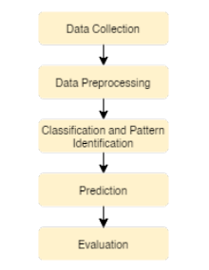
System Architecture

Slide 7
System requirements
Hardware:
OS – Windows 7, 8 and 10 (32 and 64 bit)
RAM – 4GB
Software:
Python Idle / Anaconda Navigator

Slide 8
MODULES
DATA COLLECTION
DATA PRE-PROCESSING
FEATURE EXTRATION
EVALUATION MODEL

Slide 9
Proposed System Steps
1. First, we take crime dataset.
2. Filter dataset according to requirements and create a new dataset which has attribute according to analysis to be done
3. Perform k means clustering on resultant dataset formed
4. From result plot data between crimes and get required cluster
5. Analysis can be done on cluster formed by perform Supervised classification algorithm on resultant dataset formed
6. Finally you will get results as accuracy metrics

Slide 10
Algorithms Used
K-Means
Support Vector Machine
Logistic Regression
Random Forest

Slide 11
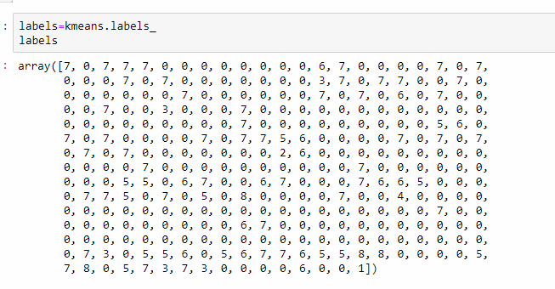
Labels Generated by K-Means

Slide 12
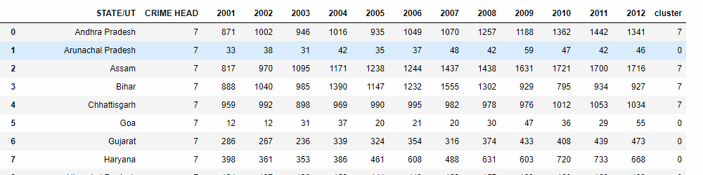
K-Means Result

Slide 13
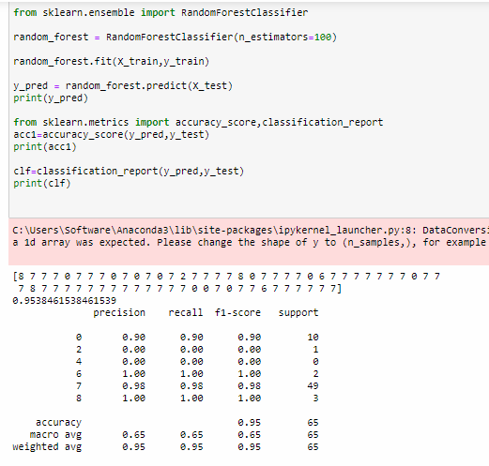
Accuracy result with Random Forest

Slide 14
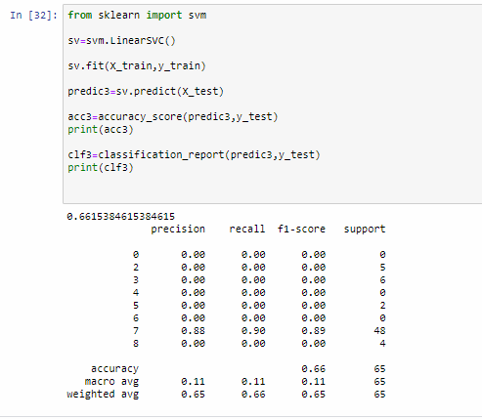
Accuracy result with SVM

Slide 15
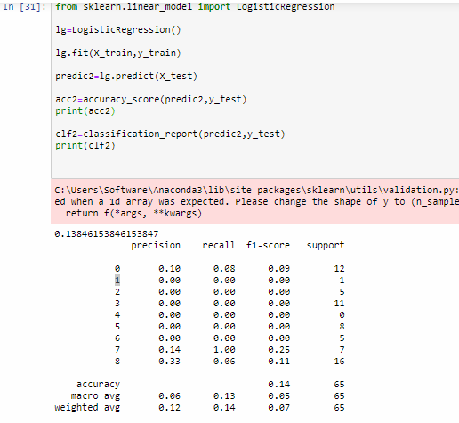
Accuracy Result with Logistic Regression

Slide 16
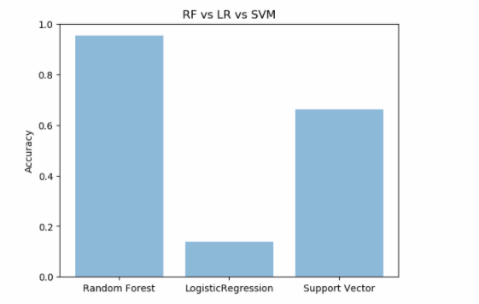
Comparative model Accuracy graph

Slide 17
Conclusion
Crime prediction is one the current trends in the society. Crime prediction intends to reduce crime occurrences. It does this by predicting which type of crime may occur in future. Here, analysis of crime and prediction are performed with the help of various approaches. From the results obtained we saw that the training time of Random Forest is very high thus it should be avoided for this dataset. However which model will work best is totally dependent on the dataset that is being used.

Slide 18
Future Scope
As of now, the project relies on manual input from a human (a police officer) in order to enter details in the database. If we can make this a centralised system and connect it to all the police stations countrywide and make FIR reporting digital, then it would be quite easier to predict crimes in that particular location and recognise patterns in them.
It would also encourage citizens to track their E-FIR online. We can also avoid corruption as the government can keep a track on the number of cases registered and their solvability rate which can help them utilise their resources better.

